Slide 1

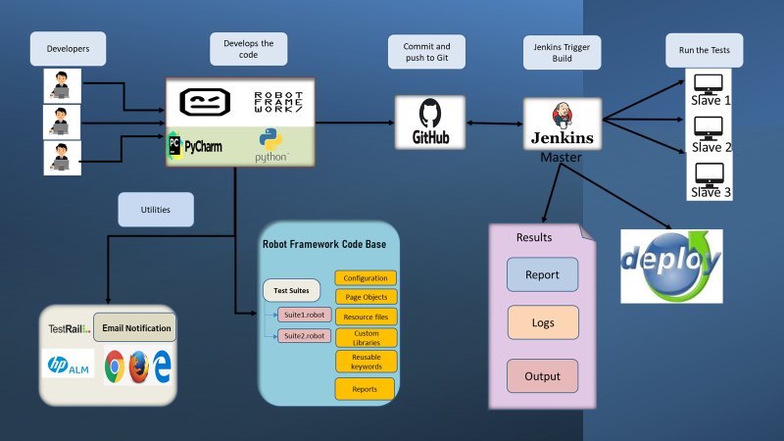
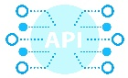



Holistic Test Automation Ecosystem
Multiple Automation platform to maintain various Testing types
Large scope for Automation area which can be covered with existing method
Not Common repository for regular use methods, which does not improve reusability
No Parallel Execution done to reduce execution time
Manually Test Management Tools are updated
No Proper common reporting is maintained
Implement a Common platform to cater multiple Testing Areas(Web, Mobile, API, Mainframe, Desktop etc.)
Common Easy-to-Understandable Reporting
Integration to Test Management Tool to update automatically post execution
Introduce Parallel Testing to reduce the execution time to cover major scope in less time
Integrate to CI/CD to get a smooth execution with out manual intervention
Reduce manual prone errors
Expected reduction of execution time by 90%
Easy to maintain being a common platform
Easy to integrate with new scope with minimal modifications
Key Challenges
Solution Levers
Expected Benefits
CI/CD Integration
Detailed Reporting
API
Key Features
Digitally Powered by
Implemented on
Web
Test Management Tool Integration
Parallel Execution
Database
Robot Framework
Mainframe

